Slide 1

Introducing the Staff and Student Dignity and Respect Policies
Mini Module
Notes:
This mini module is designed for managers; EDI Leads and other interested stakeholders to share information about the launch of the Staff and Student Dignity and Respect Policies. Briefings can take place within a small team or larger group meeting.
Speaker notes:
Introduce yourself and provide context on why you are presenting this session.

Slide 2
WHAT WE WILL COVER
Background to policy review
Development of Staff and Student Dignity and Respect Policies
What is staying the same
Policy changes and improvements
What this means for staff and students
Further information and support
Notes:
Speaker notes:
Provide a brief overview of what will be covered in the session.
Depending on your time available, it will take between 10 and 20 minutes to present the slides.

Slide 3

Background to Policy Review
The previous Dignity and Respect Policy applied to both staff and students.
The policy promotes an inclusive environment, where everyone at the University should be treated with dignity and respect.
It ensures that bullying and harassment are taken seriously by providing framework to address and resolve issues.
Notes:
Speaker notes:
Go through the points on the slide.

Slide 4

Development of Staff and Student Dignity and Respect Policies
Decision to separate policies with staff and student specific reporting routes and examples, whilst maintaining the same standards of expected behaviour across the University community.
Staff will use the Staff Dignity and Respect Policy to report concerns, while students will use the Student Dignity and Respect Policy. Report + Support is available if staff or students are unsure.
A Student Dignity and Respect Policy was launched at the same time as the Staff Dignity and Respect Policy on 26 October 2026.
Notes:
Speaker notes:
Go through the points on the slide on the development of the Staff and Student Dignity and Respect Policies.

Slide 5

What is Staying the Same
Staff and Student Dignity and Respect Policies provide a framework for expected standards of behaviour and link to other processes when issues are raised.
The Grievance Policy, Disciplinary Policy, and Student Code of Conduct remain the same.
The same core standards of behaviour apply across the University community.
Report + Support can be used by staff and students to report unacceptable behaviour and access support either anonymously, or providing their contact details.
Notes:
Speaker notes:
Go through the points on the slide. This slide covers what is staying the same and not changing even though updated policies have been introduced.

Slide 6
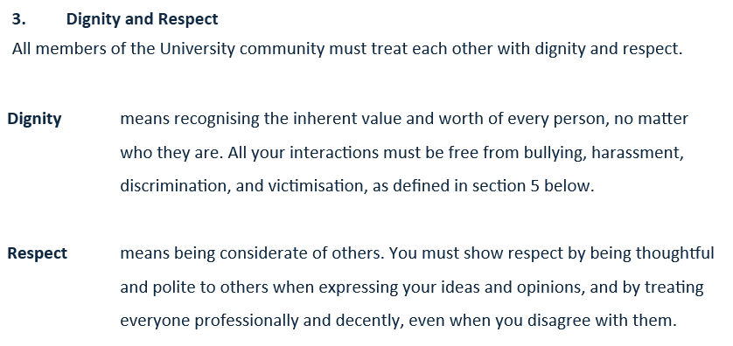

Main Policy Changes – “Dignity” and “Respect” Defined
Notes:
Speaker notes:
Read out the definitions of dignity and respect and direct staff to the policies for further information. The previous policy did not define dignity and respect, so this is one of the main policy changes.
The definitions are the same across the Staff and Student Dignity and Respect Policies, with the only difference being that "professional" is used in the staff context.

Slide 7
Other Key Changes
Support Options: New section on support mechanisms for staff and students.
Witness Behaviour: Encourage witness reporting and active bystander behaviours.
Bullying vs. Reasonable Management: Clearer distinction between bullying and legitimate managerial actions in the staff policy.
Freedom of Expression: New section on navigating the boundary between harassment and freedom of expression.
Abuse of Power: Is defined and the contexts in which this can occur are explained.
Confidentiality: New section introduced to set expectations and define limits on anonymous reporting.
Online Conduct: A new section addressing online bullying and harassment.
Contextual Examples: Clear, relevant examples of bullying and harassment for each protected characteristic specific to staff and students.
Notes:
Speaker notes:
Go through the points on the slide and cover the other main policy changes.
All of the points on this slide are improvements to the previous policy and demonstrate new content added.

Slide 8
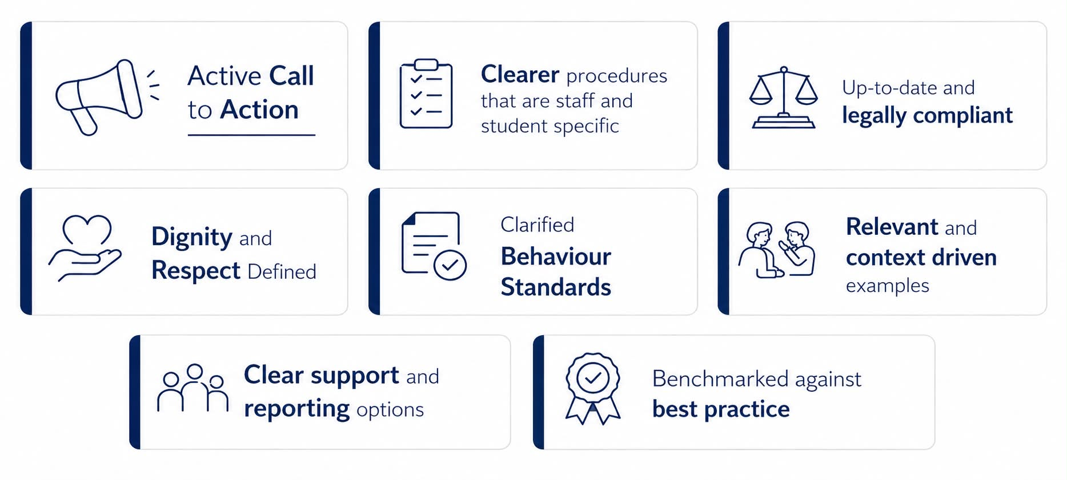
Policy Improvements
Notes:
Speaker notes:
Go through the policy improvements on this slide.
"Active call to action" means that the policies are more proactive than the previous policy version. The policies encourage witnesses to report unacceptable behaviour and promote active bystander behaviours.

Slide 9
Impact for Staff and Students
Clearer definitions and expectations of dignity, respect, and unacceptable behaviour for all members of the university community
More relevant examples and guidance for both staff and students to support understanding and consistent application
A clearer call to action for staff and students who witness unacceptable behaviour, helping to create a more proactive and accountable culture
Greater clarity on key issues such as reasonable management, abuse of power, freedom of expression, and online conduct, where relevant across different roles and contexts
Clearer information on support, reporting, and confidentiality to help staff and students feel more confident raising concerns
Notes:
Speaker notes:
Go through the points on the slide.

Slide 10
Links to Policies and Resources
Resource Description | Link
The Staff Dignity and Respect Policy | A – Z of HR Policies
The Student Dignity and Respect Policy | A to Z | Academic Quality and Standards | Registry Services
Active bystander guidance, links to both policies, training and further information about dignity and respect at the University | Respect at Edinburgh | Equality, Diversity and Inclusion
Contact for questions about the Staff Dignity and Respect Policy, or for assistance with raising staff issues formally or informally | HR Helpline, Report + Support
Contact for students to raise issues formally or informally | Report + Support
Notes:
Speaker notes:
This slide provides information on how to access the policies and where to go for more information. Talk through the slide and let staff know where to go for more information.

Slide 11
Notes:
Ask if anyone has any questions. Refer to manager guidance if needed: A to Z of HR Policies | Human Resources | Human Resources

